Slide 1

Suicide Rate Prediction
Akhila Seetannagari

Slide 2
Introduction and Motivation :
Every year, 7,03,000 individuals commit suicide, with many more attempting to commit suicide.
Suicide affects people of all ages and was the world's fourth biggest cause of death among 15–29-year-olds in 2019.
Suicide is a severe public health issue, but it may be avoided with early, evidence-based, and frequently low-cost treatments. A comprehensive multisectoral suicide prevention strategy is required for effective national responses.
Need for this project-Given the current disaster, the world's largest healthcare administrative authorities urge that suicide prevention be accomplished through the comprehensive examination of risk and protective variables and related measures. In a society where technology is present in every area of human life, it would be a pity if that same technology did not provide a means of identifying prospective suicide victims.
My current study focuses on projecting suicide rates by examining and finding signals associated with greater suicide rates across diverse socioeconomic groups throughout the world.
Data Source: https://www.kaggle.com/

Slide 3

Dataset Description and Preprocessing :
The Suicide Rates Overview 1985 to 2016 dataset which is taken from Kaggle consists of 27820 rows and 12 columns.
It is compiled from four different datasets ( United Nations Development Program (HDI), World Bank, World Health Organization, and Szmali) to identify any attributes that correlated with suicide rates globally.
The data is readily available and downloaded in CSV format.
There seems to be several null values in the “HDI for year” column hence this column can be dropped.
gdp_for_year($) column should be converted to int/float by replacing the commas with spaces.
Non-numerical labeled columns(Country, year, sex, age and generation) should be converted into numerical labels using SkLearn's LabelEncoder
Machine learning estimators need dataset standardization: if the individual features do not resemble standard normally distributed data, they may perform poorly. SkLearn's RobustScaler is used to normalize the numerical columns- population, gdp_for_year, and gdp_per_capita.
The problem of predicting suicide rates can be resolved by Regression approach. This is because it helps us to determine which factors matter most, which factors can be ignored and how these factors influence each other.
There are 12 features in the original dataset. We could drop country-year column as this is repetitive.

Slide 4
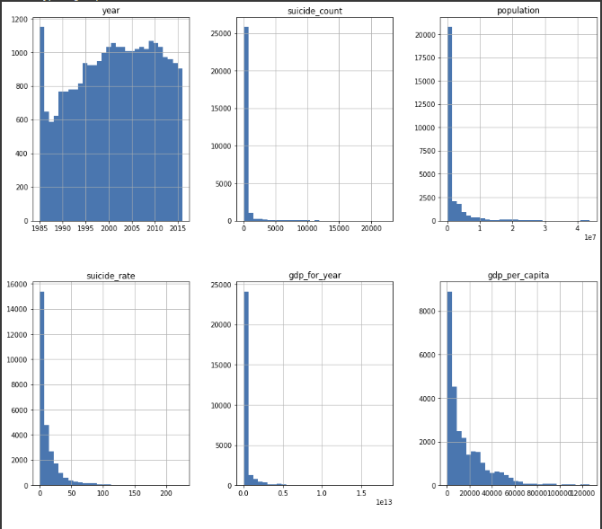
Data Distribution Plots

Slide 5
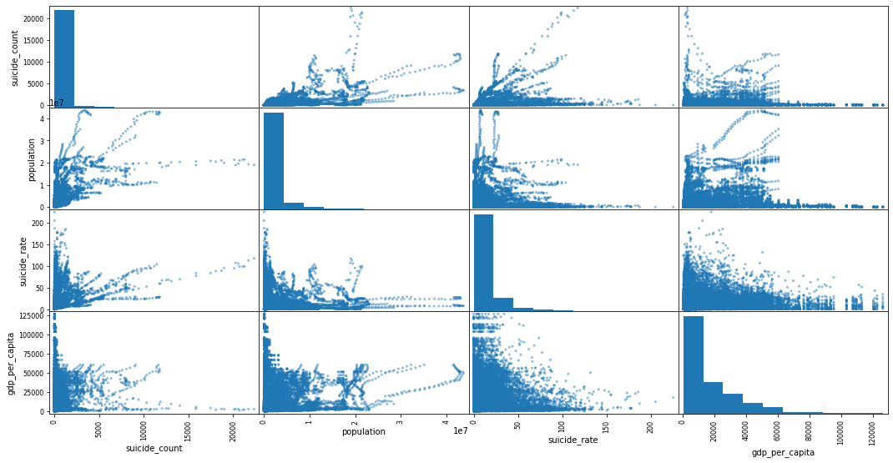
Outlier Analysis : Scatter Matrix to find outliers

Slide 6
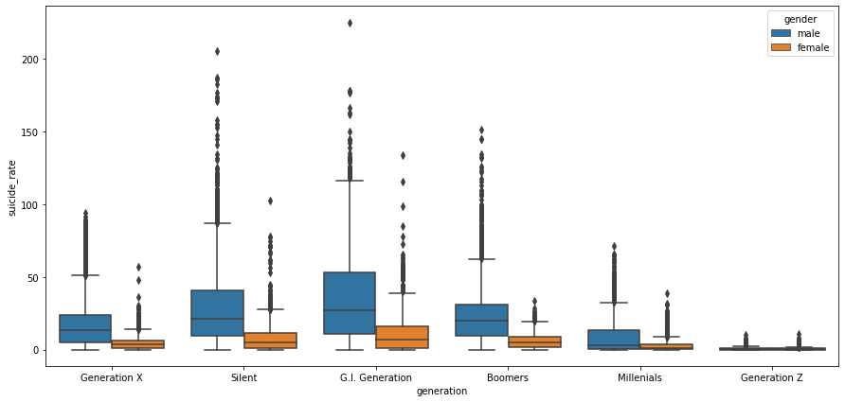
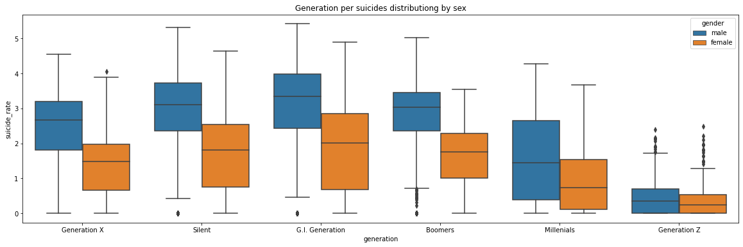
Box plots before and after outlier treatment

Slide 7
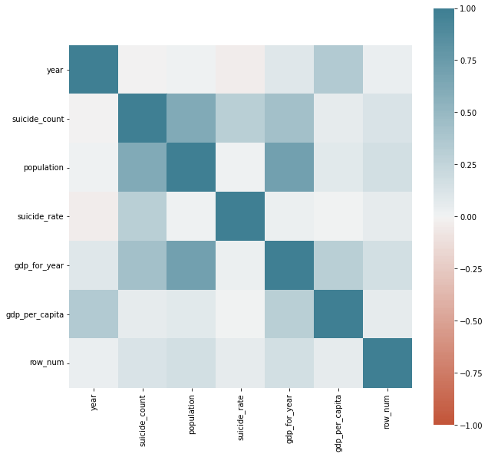
Exploratory Data Analysis:

Slide 8
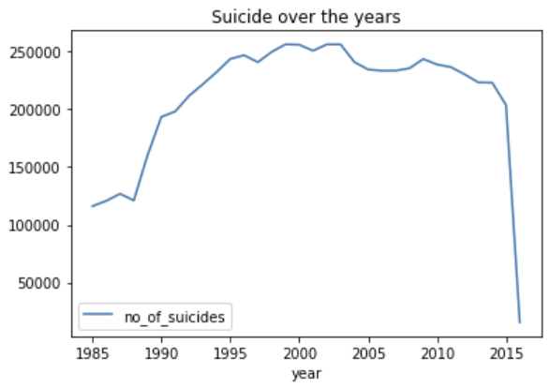
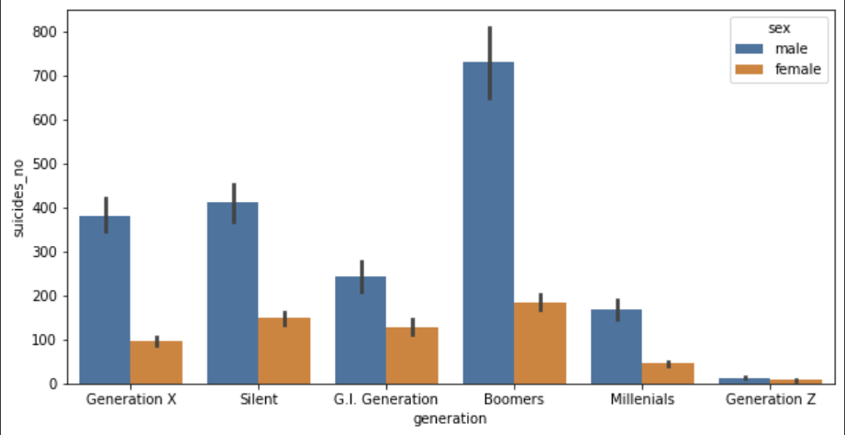
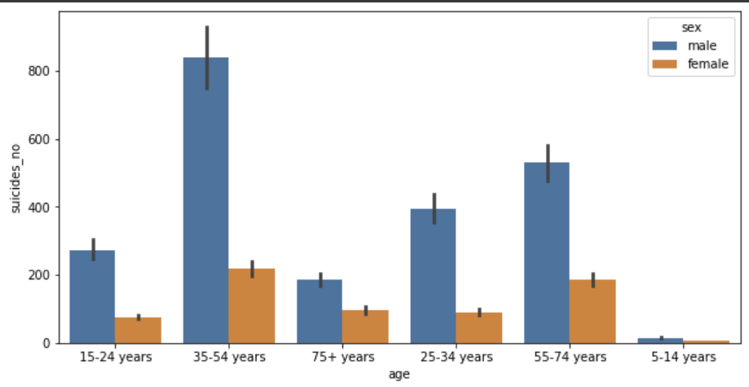
Suicide rates have consistently increased over time. After a few dips in 1997 and a continuous reduction from 2002 to 2008, the rate increases and then drops from 2009 to 2015. The below two graphs help us understand that men commit suicide at a much higher rate than women, regardless of their age or generation.

Slide 9
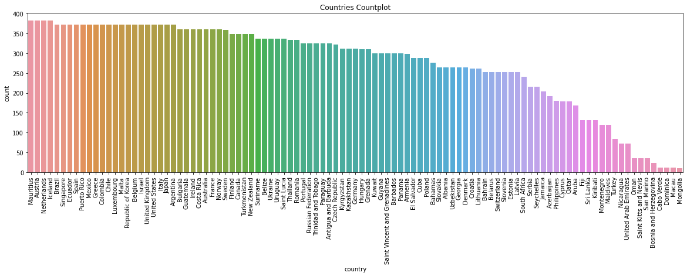
Suicide Count Plot by County : The highest suicide count is in Mauritius whereas the lowest suicide count is in Mongolia

Slide 10
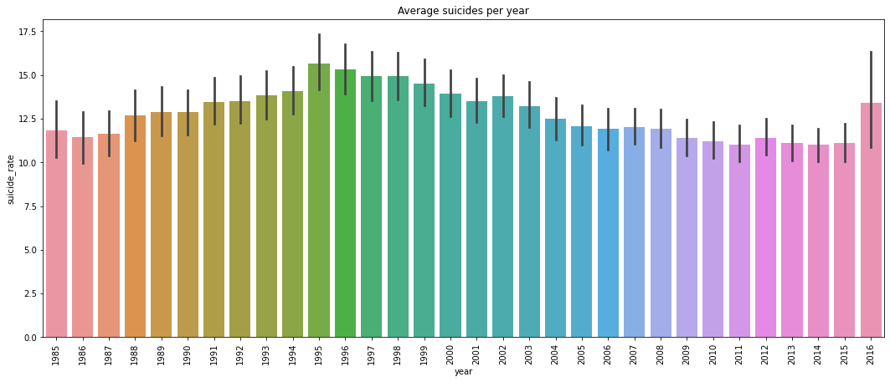
Average suicides per year : Suicides per year were the highest in 1995.

Slide 11
Takeaways from EDA :
The ratio of males who commit suicide is considerably higher than that of females, irrespective of their age or generation.
Suicide is most common among those aged 35 to 54.
Suicide rates were significantly lower towards the start of the time period.
Suicides among the Baby Boomers are at an all-time high.
Several nations have high GDP per capita yet low GDP per year.
Often countries with less population tend to have higher GDP per capita when compared with countries with high population.
There is insufficient evidence to conclude that GDP and suicide have a substantial relationship. However, there are countries with low GDP per capita with high suicide rates and countries with high GDP per capita with low suicide rates.

Slide 12
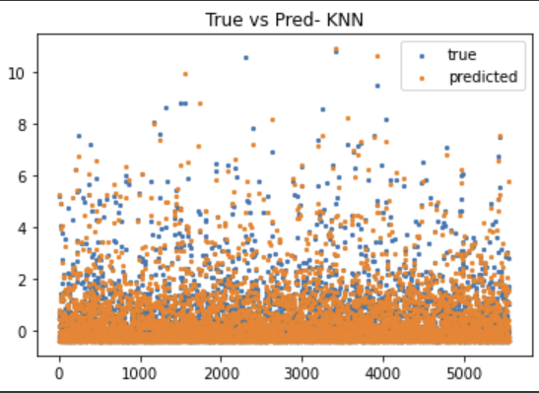
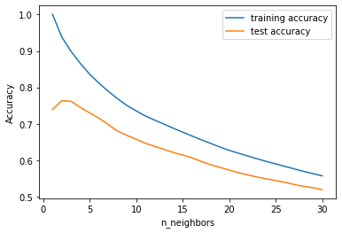
Regression Modeling :
We set the “suicide_rate “ as dependent variable and the remaining columns as independent variables. Later we used the train_test_split to split our data into testing data and training data with test_size as 0.2.
The supervised machine learning models trained on this dataset are : K-Nearest Neighbors , Decision Tree and Random Forest , XG Boost and Multilayer Perceptrons.
K Nearest Neighbor Regression
Accuracy - 0.771, RMSE- 0.279
The scatter plot shows the true vs predicted values. The line graph shows the training vs testing accuracy. Overfitting is seen by the difference in performance between the training and testing sets. The performance isn't as good, we can move on to the next models.

Slide 13
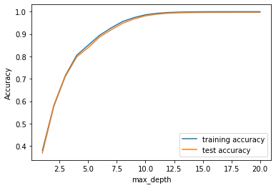
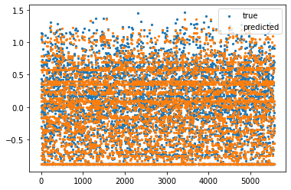
Decision Tree Regression - Accuracy - 0.967, RMSE- 0.105
The scatter plot shows the true vs predicted values. The line graph shows the training vs testing accuracy .
The performance of the model has considerably increased when compared to K Nearest Neighbor Regression.

Slide 14
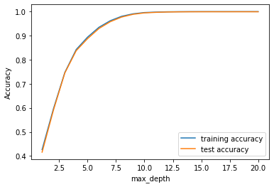
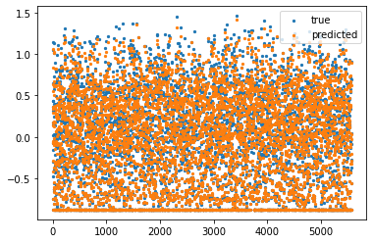
Random Forest Regression - Accuracy - 0.988, RMSE- 0.063
The scatter plot shows the true vs predicted values. The line graph shows the training vs testing accuracy.
The random forest achieves a 98.8 percent accuracy, which is superior to K nearest or decision tree models.

Slide 15
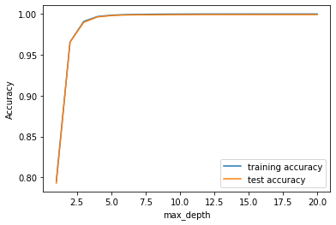
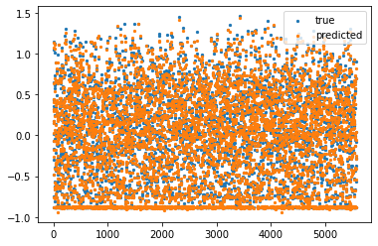
XG Boost Regression - Accuracy - 0.997, RMSE- 0.029
XGBoost is one of the most popular machine learning algorithms these days. XGBoost stands for extreme Gradient Boosting. This can be implemented regardless of the type of prediction task at hand; regression or classification.
XGBoost is an implementation of gradient boosted decision trees designed for speed and performance.
The scatter plot shows the true vs predicted values. The line graph shows the training vs testing accuracy.
The XGBoost Regression has demonstrated the highest accuracy and least RMSE so far of 0.997 and 0.029 respectively.

Slide 16

Multilayer Perceptrons : Deep Learning
Multilayer perceptrons (MLPs) are also known as feed-forward neural networks, or sometimes just neural networks. Multilayer perceptrons can be applied for both classification and regression problems.
MLPs can be viewed as generalizations of linear models that perform multiple stages of processing to come to a decision.
This model gave us an accuracy of 0.887 which is lower compared to XGBoost regression.

Slide 17
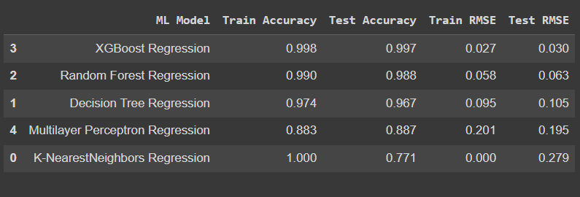
Results:
Data analysis helped us understand several underlying trends in suicide attempts over the years 1985 and 2016. Coming to the performance of the four machine learning models - Among all the trained models, XGBoost has the highest accuracy and lowest RMSE. This is because XGBoost is very good in execution Speed & model performance. Random forest had an accuracy of 98.8%, followed by Decision Tree, Multilayer Perceptrons and K-Nearest Neighbors with 96.7, 88.7 and 77.1 % respectively.

Slide 18

References
https://medium.com/@sahaanadas/studying-suicide-rates-from-1985-to-2016-prediction-using-machine-learning-7c6aa1491233
Studying Suicide Rates from 1985 to 2016 : Prediction using Machine Learning
Author : Sahaana Das

